Slide 1
AGENCY
“HOW TO DO GUIDE”

Slide 2
HOW TO LOG INTO UNIVERSE

Slide 3
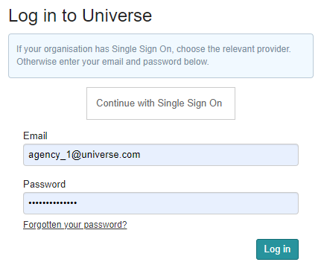
Signing In To Universe?
Open your web browser and go to Universe (universe.datumrpo.com). You will have already received your email address and password from IT.
The Universe application has been modified to allow users to use their normal network password for access. All other users will experience no change to the password they use.
On the first screen, every user is required to enter in their email address and password, then to click the Log in button.​
TOP TIP - save Universe to your favourites tab in your browser so you can locate it quicker!

