Slide 1
AGENCY
“HOW TO DO GUIDE”

Slide 2
PLAN OVERVIEW

Slide 3
SHIFT ALLOCATION

Slide 4
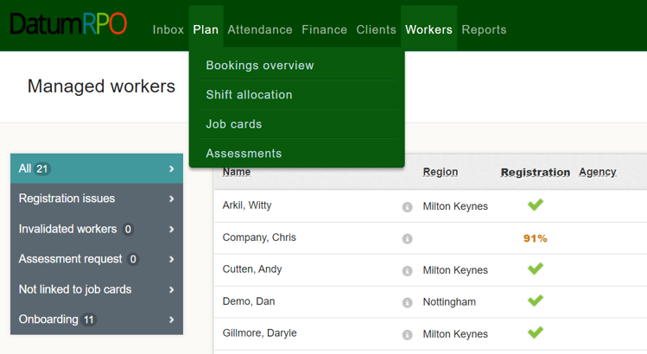
Where To View Preferences On Shift Allocation?
Log in to Universe & click on Plan, then Shift Allocation

Slide 5
Where To Change View Preferences?
To extend your planner view click on ‘Full Screen’ – this will hide the top section of the page and allow you to view more workers at the same time

Slide 6
Where To View Sites And Follow?
You can view and find your site from this location and follow/unfollow your sites here too.

Slide 7
Where To View Site Overview?
You can view a site overview of any unallocated shifts for your job cards.

Slide 8
Where To View Job Cards?
At the top of the page, you can view job cards by selecting all, unselecting all or selecting one job card.
You can also select the specific job card you want to add shifts to from the dropdown.

Slide 9
Where To Set View For Published Shifts?
You can change your publishing preferences by clicking the wrench icon
(you can go set this to ‘publish straight away’, or ‘plan then publish’ - we recommend to set this publish straight away.)

Slide 10
Where View, Create Shifts & Allocate Workers?
Next, you can view create shifts and allocate workers from here.

Slide 11
How Do I Allocate Shifts?
You will now see the shifts you have created, the option to create additional new shifts and the option allocate the shifts.

Slide 12
How To View Dates And Overview?
You can also view the date and day and if you click on workers, you will be able to view a real time plan.

Slide 13
How Do I View Created Shifts For Each Job Card?
To create shifts, first select the job card you want to create the shifts for using the dropdown box.

Slide 14
How Do I View Created Shifts?
You will now see the shifts which have been created.

Slide 15
How To View Filters?
Across from dates you will see 'Filter'. There are many different filters you can use.

Slide 16
How To View Downloads?
From here you can download the shift allocation plan as a CSV file.

Slide 17
How To View Colour Shift Patterns?
Here you can see allocated colour shift patterns associated to workers.

Slide 18
Who Has Notes?
Here you can see if the worker has any notes on their profile – where a worker has a note, the message box will show darker.

Slide 19
Where To Find Different Information Filters?
Finally, you have a dropdown that has many options to choose from to see specific information about that worker.

