Slide 1
AGENCY
“HOW TO DO GUIDE”

Slide 2
ASSESSMENTS

Slide 3
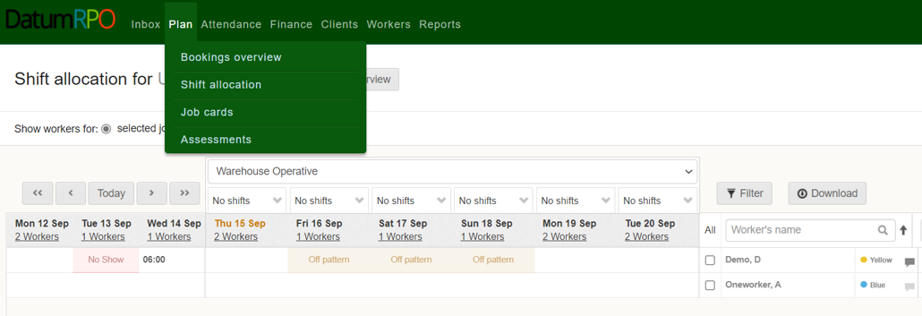
Where To Go To Book Assessments?
To view or create assessments, go to ’Plan’ and select ‘Assessments’

Slide 4
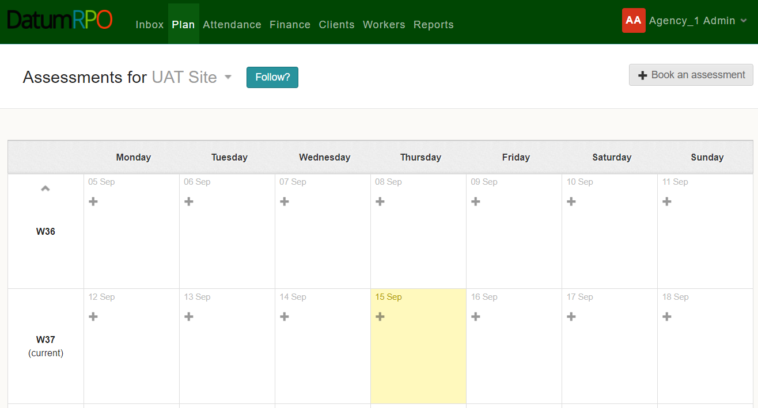
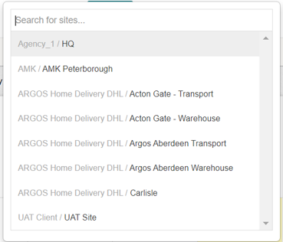
Where To Go To Book Assessments?
Next, use the dropdown box to select the site you wish to create or view assessments for.

Slide 5
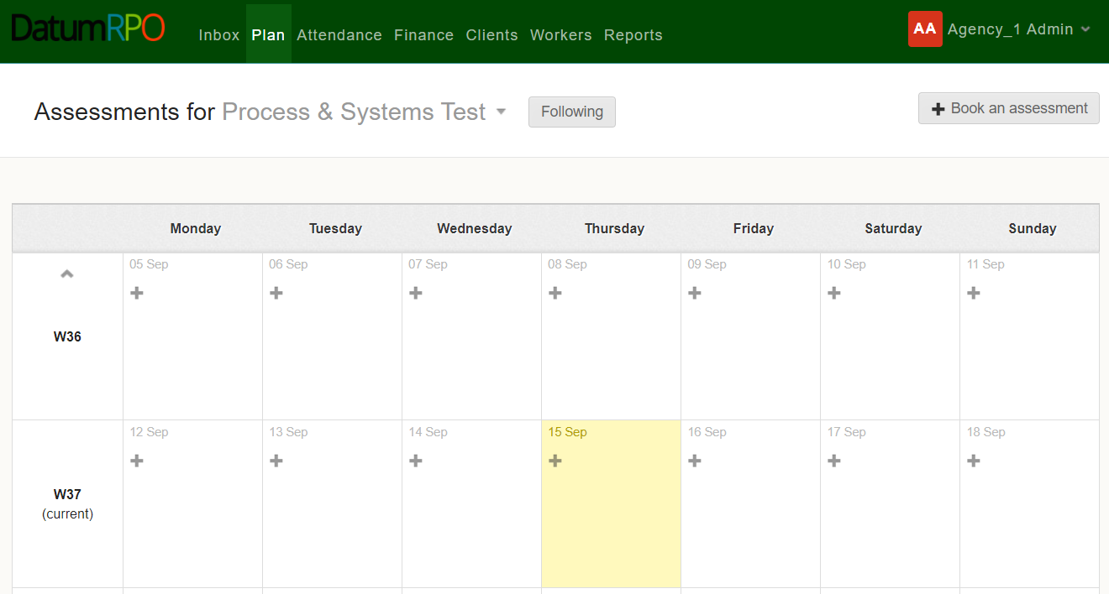
Where To Go To Book Assessments?
Click the on the date you wish to create the assessment, or you can click

Slide 6
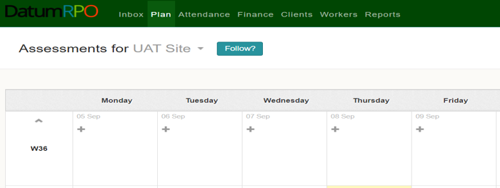
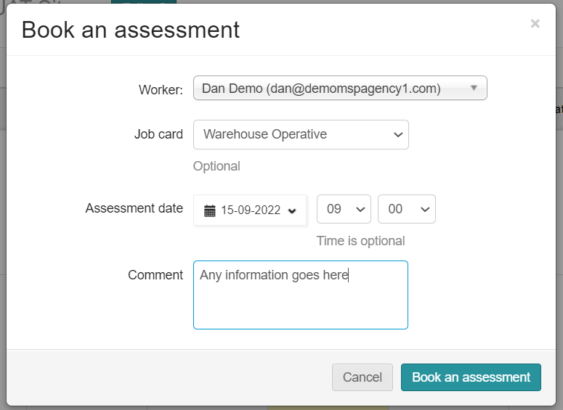
Where To Go To Book Assessments?
In the pop-up box, enter the workers name, the job card the assessment will be for, the assessment date and time (time is optional) along with any other relevant information – then click

Slide 7
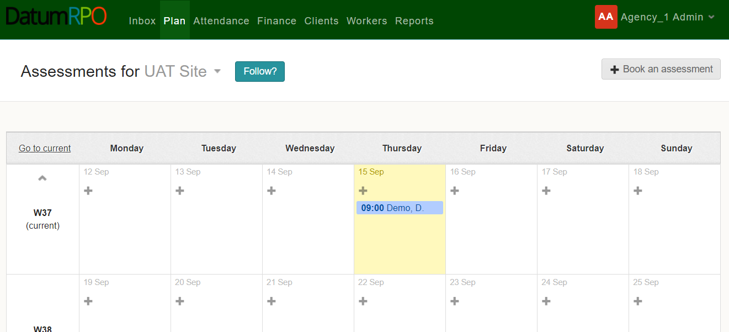
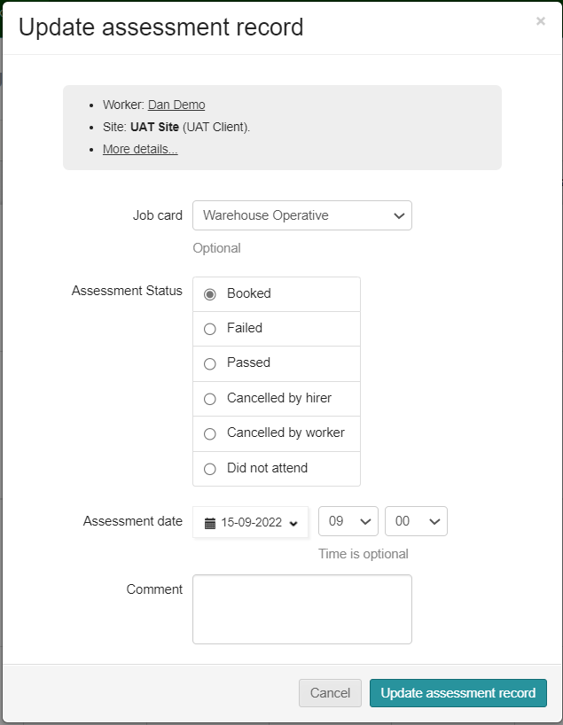
Where To Go To Book Assessments?
You will now see the assessment on the day you selected. Clicking on the assessment will allow you to update the assessment record in the pop-up box. To complete the update click

