Slide 1
AGENCY
“HOW TO DO GUIDE”

Slide 2
FINANCE OVERVIEW

Slide 3
QUERY SHIFTS

Slide 4
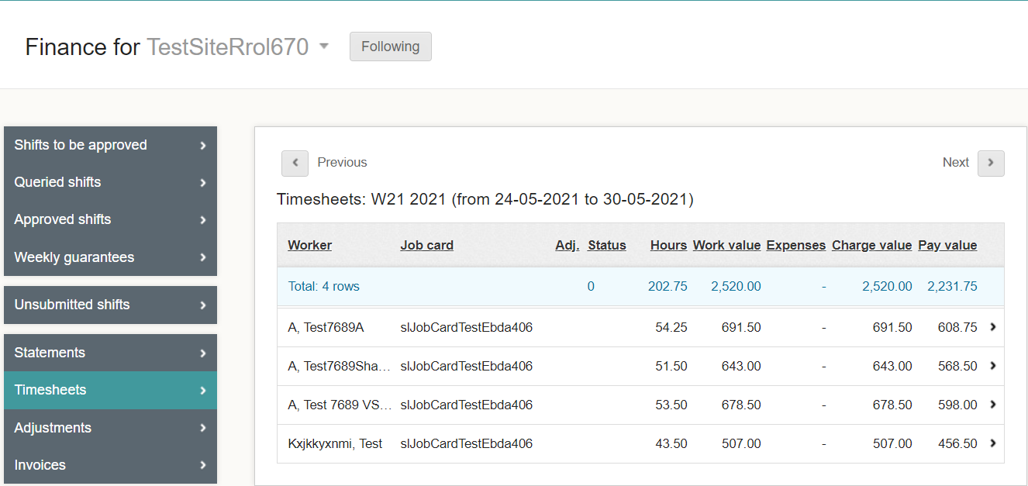
Where To Query A Shift?
A query is where you have processed hours, approved the shifts and then noticed they are overpaid or underpaid due to incorrect start/stop times.
Click on the worker where you need to
raise a query.

Slide 5
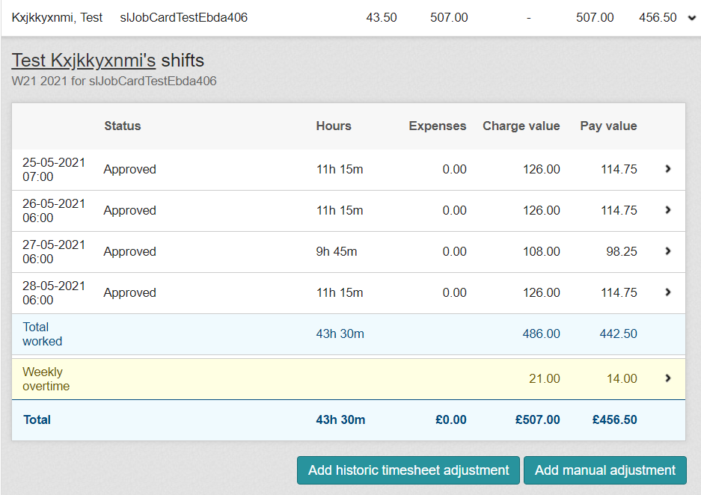
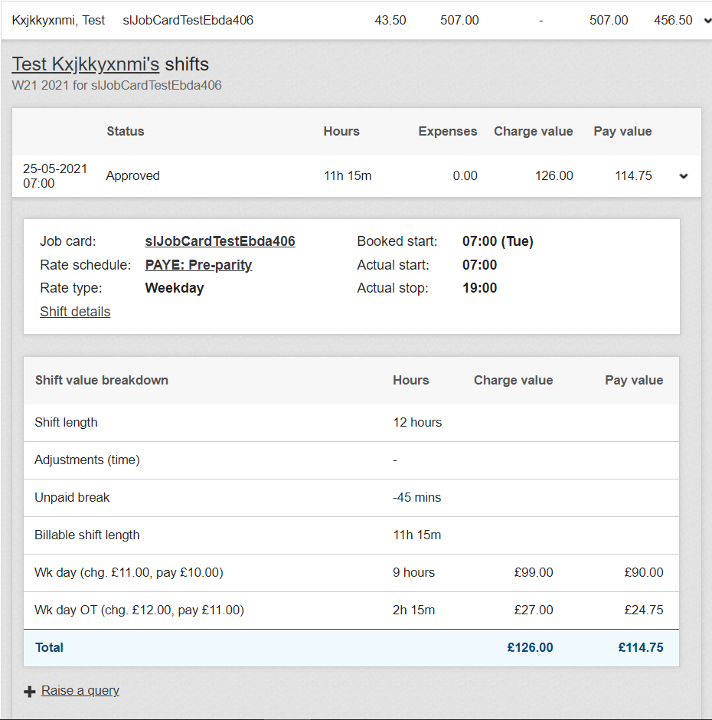
How To Raise The Query?
Open the timesheet you need to make the changes to.
Click on the 1 shift at the top
Click on Raise a qu this then will enable you to make changes.

Slide 6
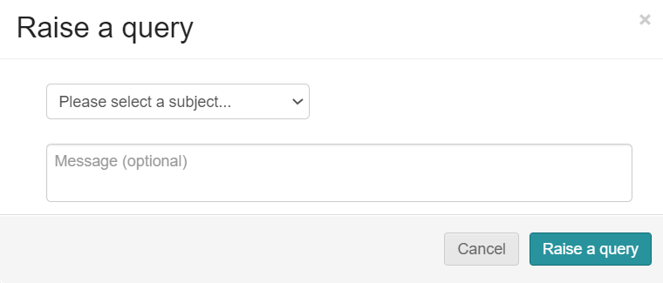
How To Complete The Query?
Open the query and select from the dropdown the reason for the query.
You can also add notes to message the worker regarding the query.

Slide 7
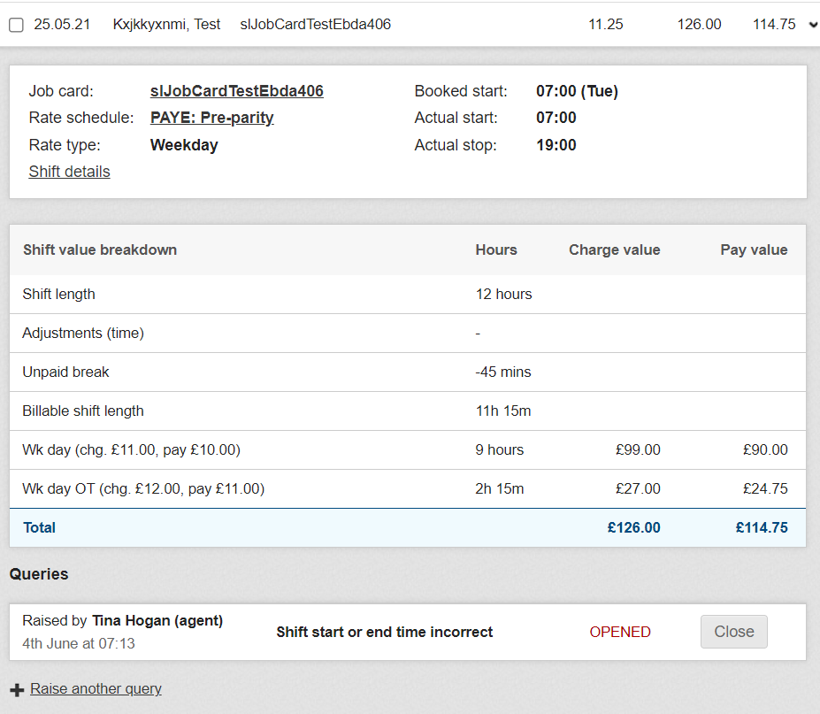
Where To Open And View Shift Details To Amend?
Go to Finance > Queried shifts.
Open the query you have created and click on shift details.

Slide 8
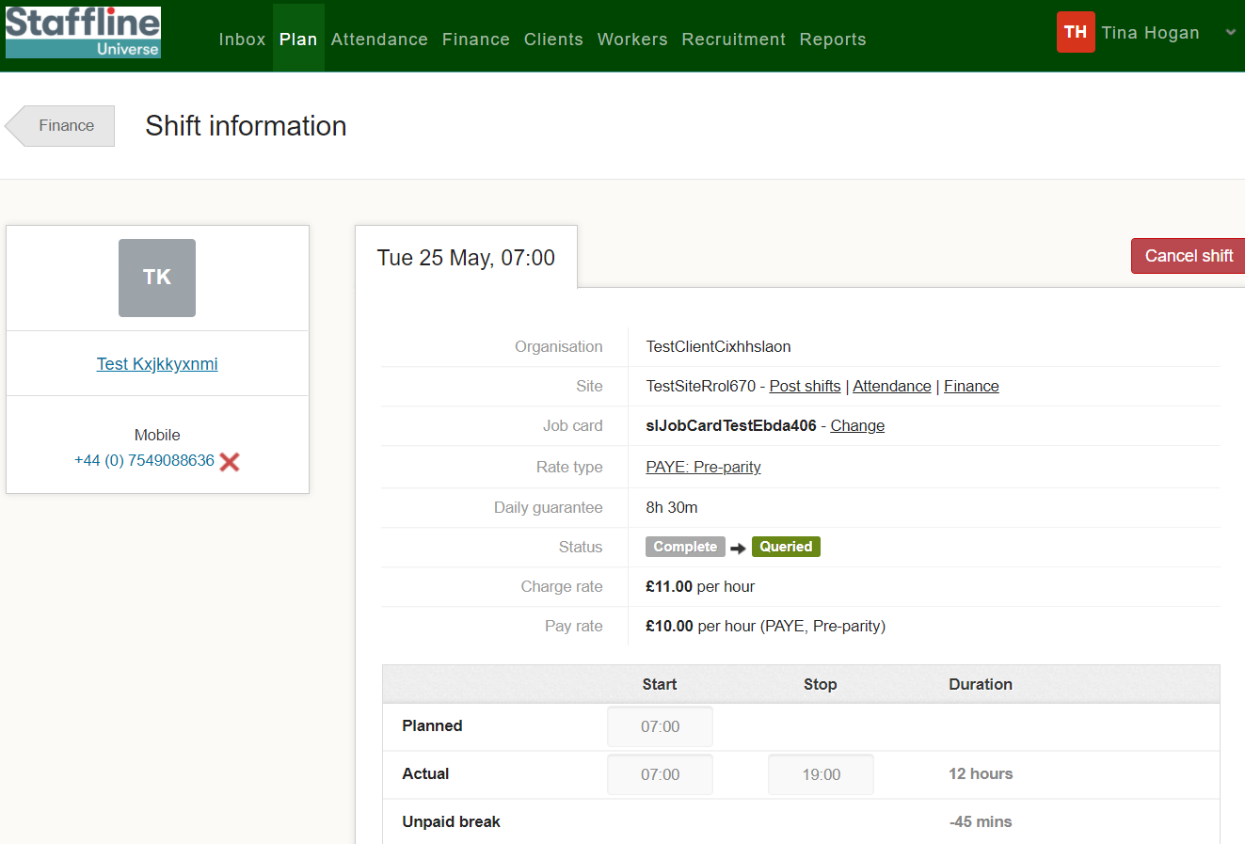
Where To Change The Time?
Click on the actual start time and change the start time to the correct time.

Slide 9
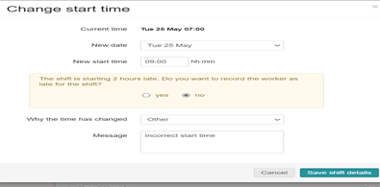
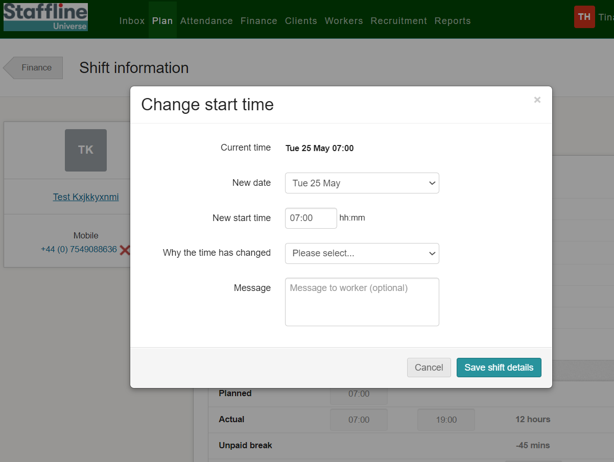
Where To Change The Time And Add Reason?
Add in the new time and use the dropdown to add in the reason. If required add a message for the worker. You will get a pop up advising on the start time, was the worker late. Click 'No' Unless they were late.
Once completed press:

Slide 10
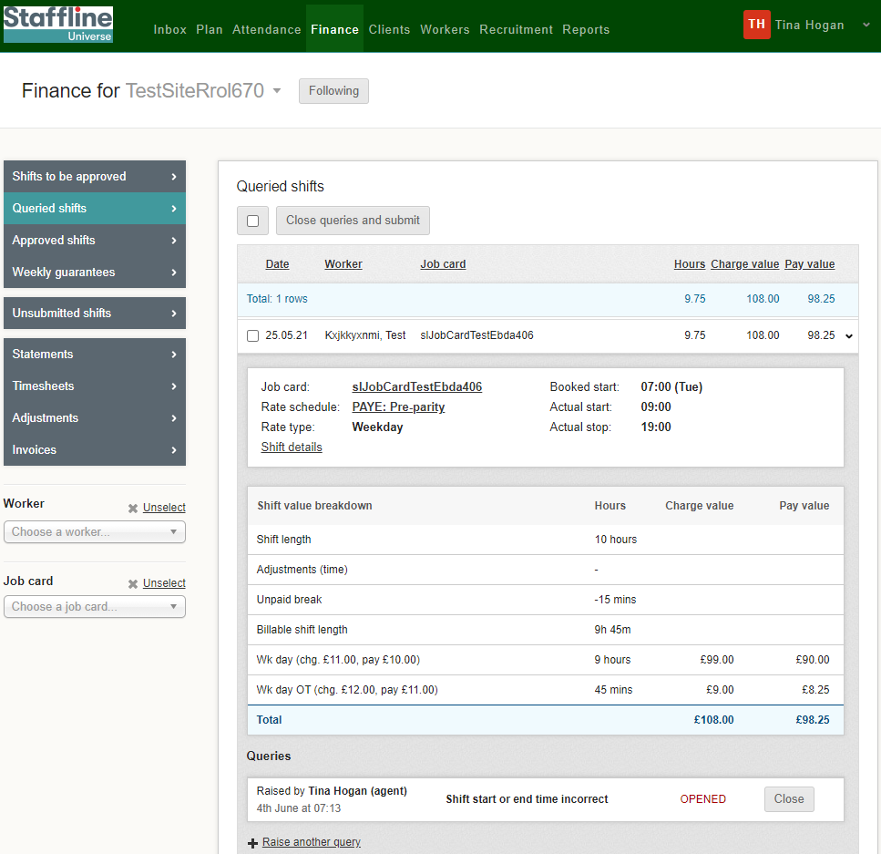
How To Close The Query?
There are two ways you can close a query under queries.
At the top of the page close queries and submit
Or close - if you click on close you will then need to resubmit your shift

Slide 11
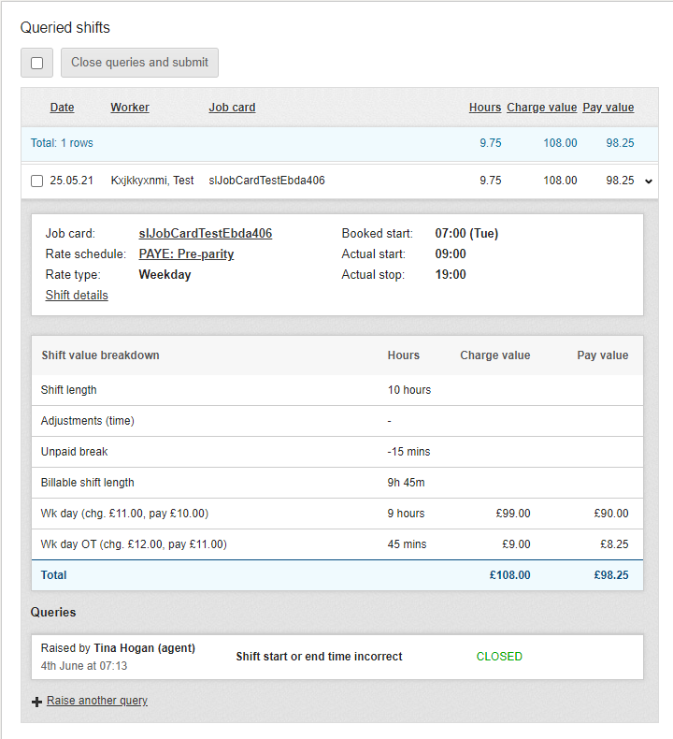
Where To View The Changes?
Once you have completed the changes you can view the closed query on the timesheet.
You have now completed how to amend, view and close a query!

