Slide 1
AGENCY
“HOW TO DO GUIDE”

Slide 2
FINANCE OVERVIEW

Slide 3
MANUAL ADJUSTMENTS -
BONUS

Slide 4
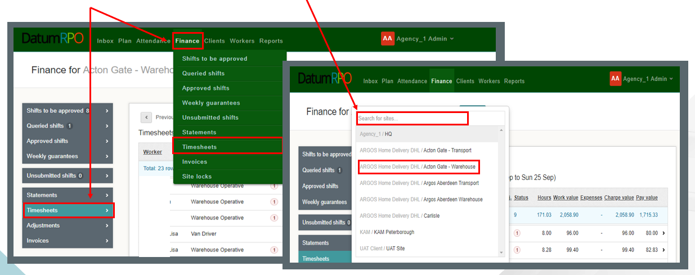
What Is A Manual Adjustment?
A manual adjustment can be entered at any time if there is a timesheet. A manual adjustment is where we need to deduct, refund or pay a shift bonus. The correct way to process this is through a manual adjustment and not an historic adjustment.
Click on Finance > Timesheets and search for your site.

Slide 5
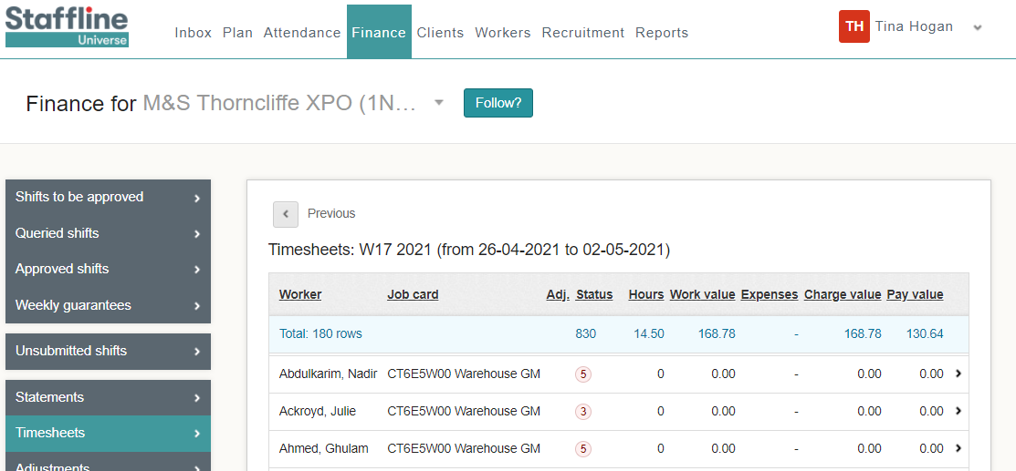
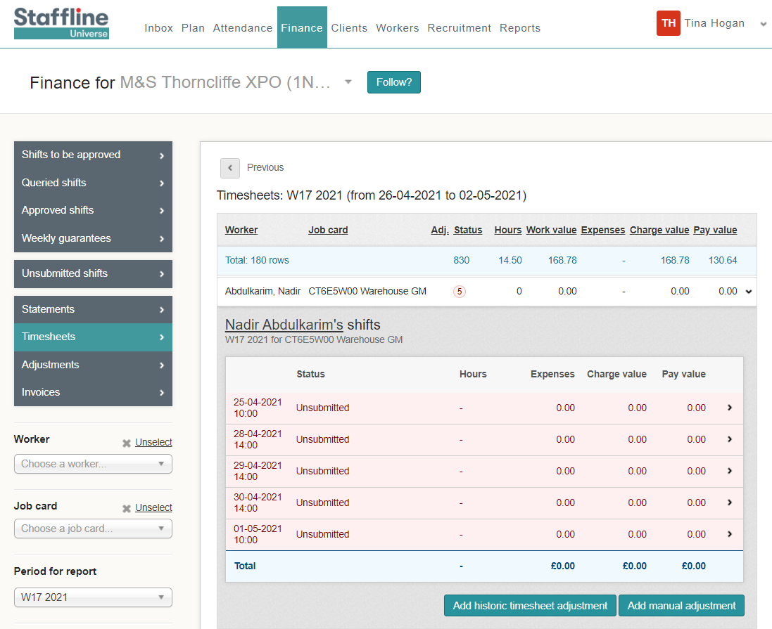
Where To Find Manual Adjustment To Add Shift Bonus?
To add a manual adjustment, click on the worker you require to make the adjustment to and open the timesheet.
cv
Next click on the workers timesheet

Slide 6
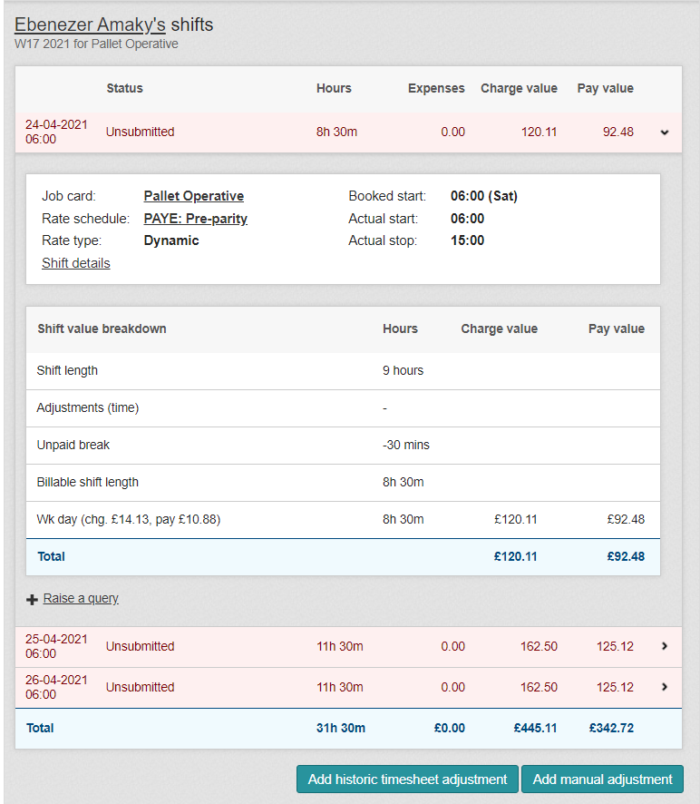
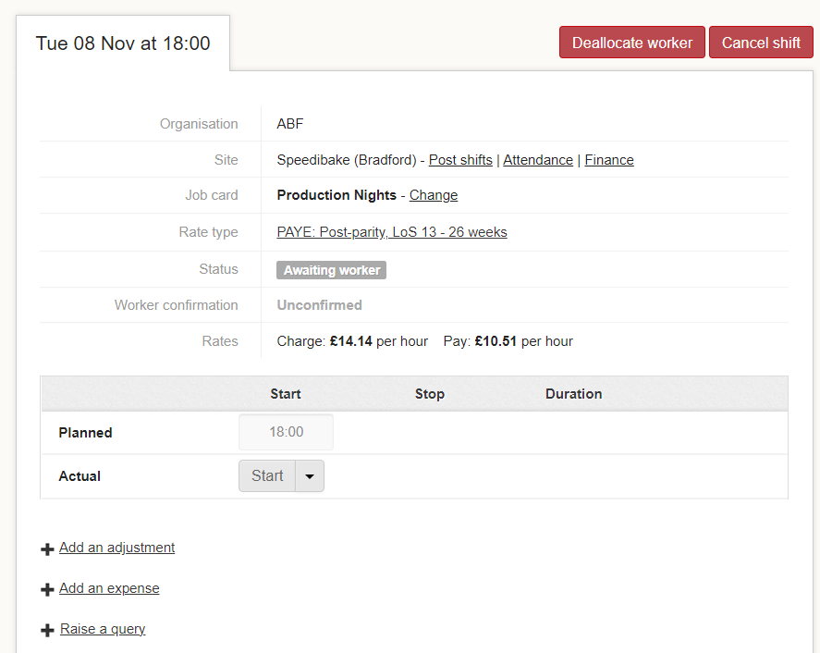
How Do I Add A Bonus?
Click on Shift details to open the workers detail to add your bonus.
Now you have opened the Shift detail page click on Add an Adjustment

Slide 7
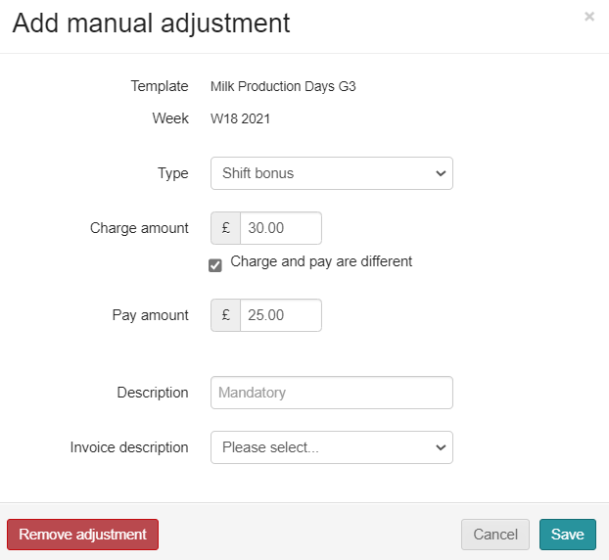
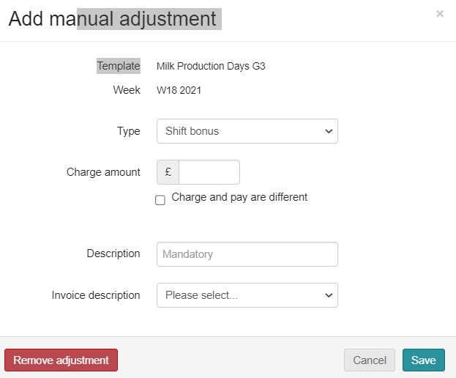
How To Add A Manual Shift Bonus Adjustment?
The manual adjustment can be entered at any time, if there is a timesheet.
Shift bonus payments are for any extra pay that is a bonus, and the worker doesn’t accrue holiday pay. This means it doesn’t go through the shift allocation but is done as a manual adjustment or a download adjustment.
Go to type and click in the box.
You will then see your drop down and click on shift bonus.
Next click on the charge amount then add the payment amount click on the
box and add amount.

Slide 8
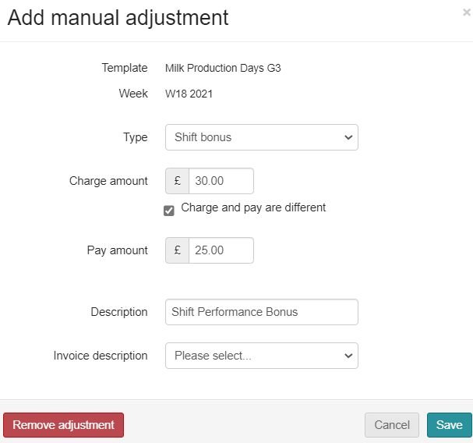
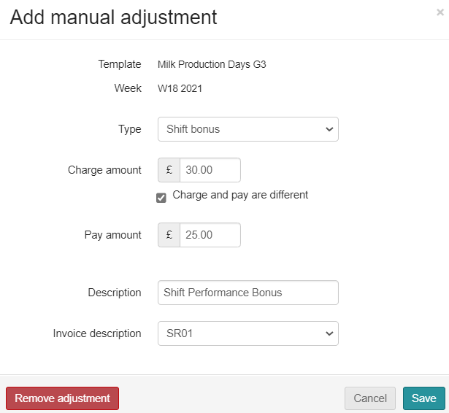
How To Add A Manual Shift Bonus Adjustment?
Next you need to add your description and invoice description.
Go to Description, click in the box and type in what it is for.
Last thing is to click on invoice description and select SR01 from the drop down.
If shift bonus is for supervisor check in don’t add charge amount, add in description 'Supervisor Check In'.

Slide 9
How To Complete A Manual Shift Bonus Adjustment?
Finally do your check list before saving.
Correct Type ✓
Correct Charge amount ✓
Correct Pay amount ✓
Correct Description ✓
Correct Invoice description ✓
Then click on

