Slide 1
AGENCY
“HOW TO DO GUIDE”

Slide 2
FINANCE OVERVIEW

Slide 3
STATEMENTS

Slide 4
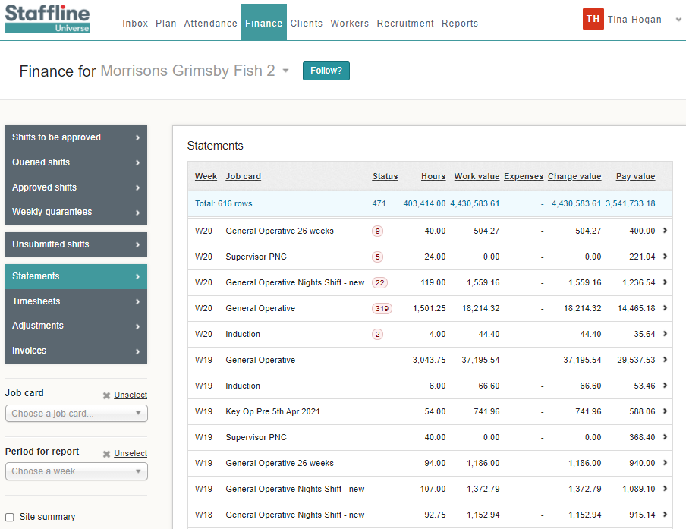
How To Find Statements?
Go to Finance > Statements
This gives you past or present timesheets where you can review hours and costings per job card.

Slide 5
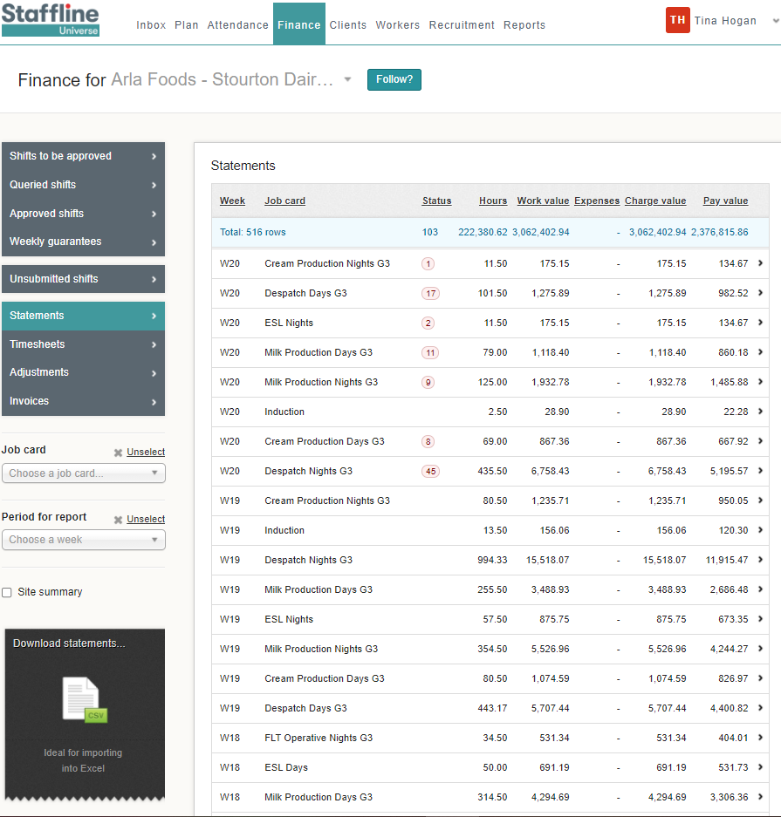
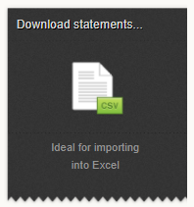
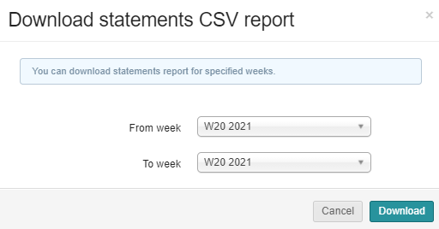
How To View Statements?
You can view a statement by downloading the CSV into excel spreadsheet.
Client on the week or weeks you require and click on download.

