Slide 1
AGENCY
“HOW TO DO GUIDE”

Slide 2
LINKING A WORKER TO A JOB CARD

Slide 3
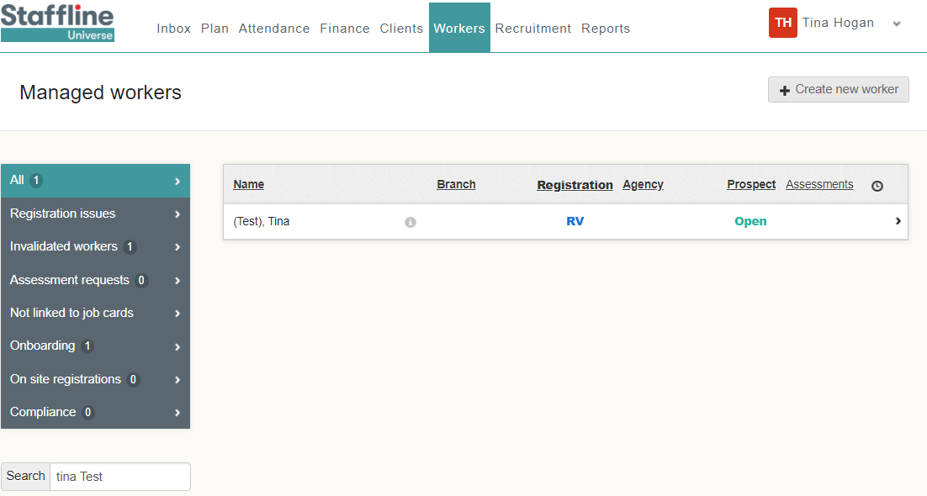
How To Search For A Worker?
Open Universe go to workers and then search for your worker in the search bar.
Once you have searched for your worker click on their name to open.

Slide 4
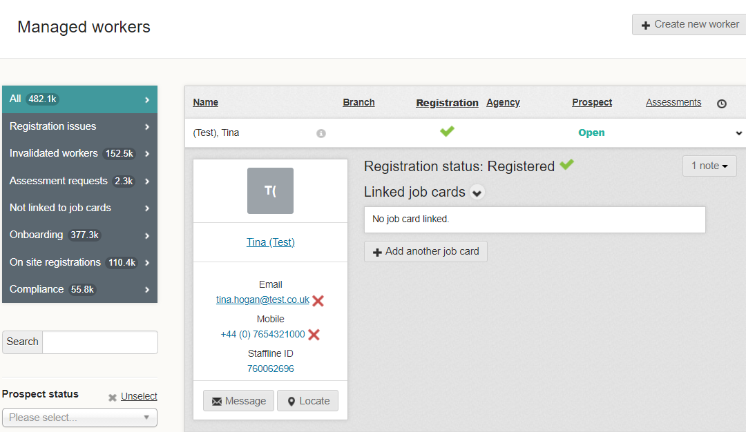
How To Add And Link Job Card?
Click on add another job card.

Slide 5
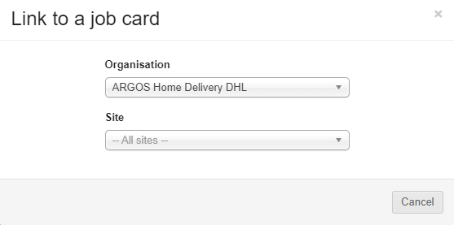
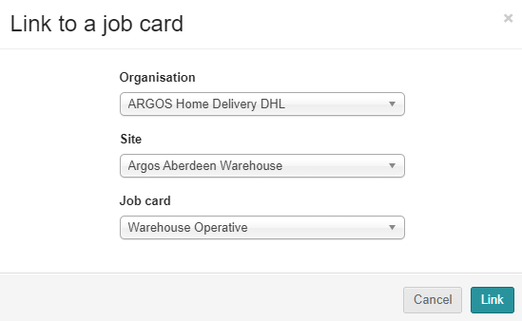
How To Link A Worker To Job Card In sections?
Click on organisation and add your site. Next click on Site.
Next allocate the job card.
Finally click link to add the job card.

Slide 6
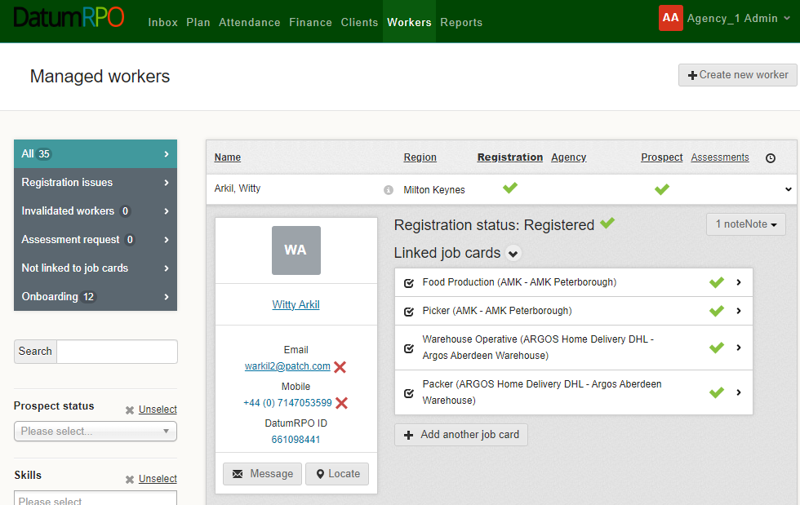
How To View The Linked Job Card?
You can now see your job card is linked to the worker. Click on add another job card to repeat the process if required.
You can also repeat this process on the workers profile!

Slide 7
UNLINKING A WORKER

Slide 8
How To Search For A Worker To Unlink?
Open Universe go to workers and then search for your worker in the search bar.
Once you have searched for your worker click on their name to open.

Slide 9
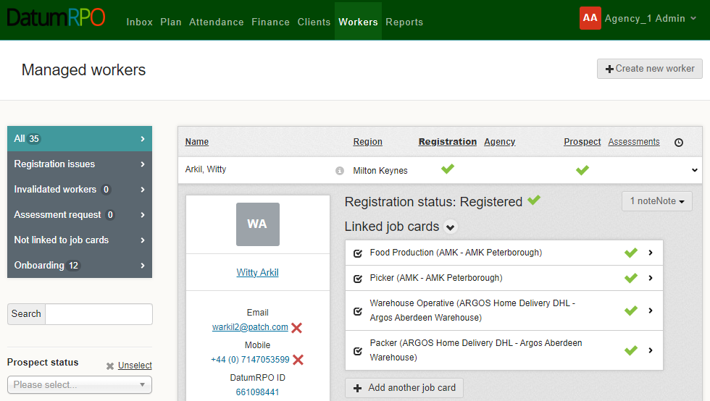
How To Link A Worker To A Job Card?
You can either go into the workers profile or click on the linked job cards.
On the left of the workers profile, select 'Linked job cards’.
Otherwise you can remove from this page.

Slide 10
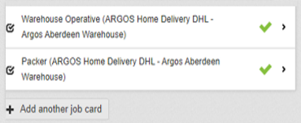
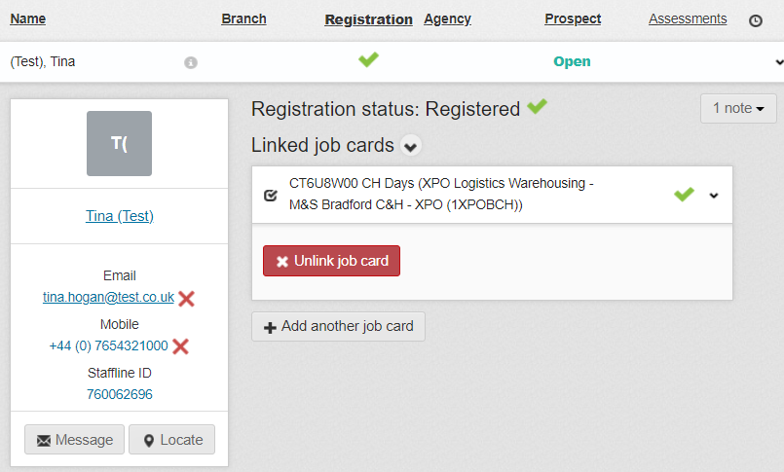
How To Unlink A Worker From Job Card?
Click on the arrow.
It will then drop down to show you
Click on the 'Unlink job card'.

Slide 11
How To Complete The Unlinking Of The Worker?
Click on the unlink and it will remove the linked job card.
This should be completed every time you stop using a worker or you make them a leaver.

