Slide 1
AGENCY
“HOW TO DO GUIDE”

Slide 2
WORKER OVERVIEW

Slide 3
WORKING TIME

Slide 4
How Do I View Working Time?
Go to Workers>Working Time

Slide 5
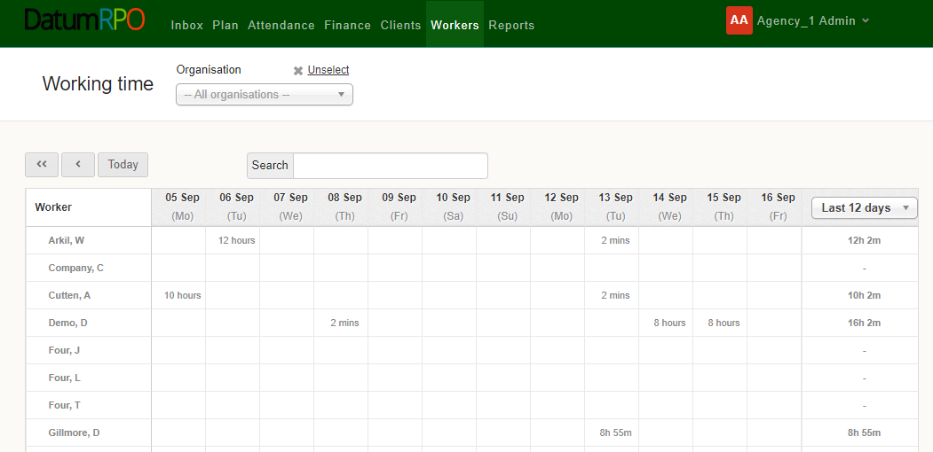
How Do I Navigate Around Working Time?
You can type in the workers name and search
You can view from 2 to 16 days
Workers Names

Slide 6
How Do I Navigate Around Working Time?
Find Your Client
Total hours for the days you have showing
Days/Dates
Hours for the day

